Slide 1
2018 Heating The Midwest Conference & Expo
Carlton, Minnesota
May 1 – 3, 2018

Slide 2
What is ‘MBIOEX?’
Notes:
A FREE internet market place for biomass
-- helping to connect buyers and sellers of woody and agricultural biomass
--

Slide 3
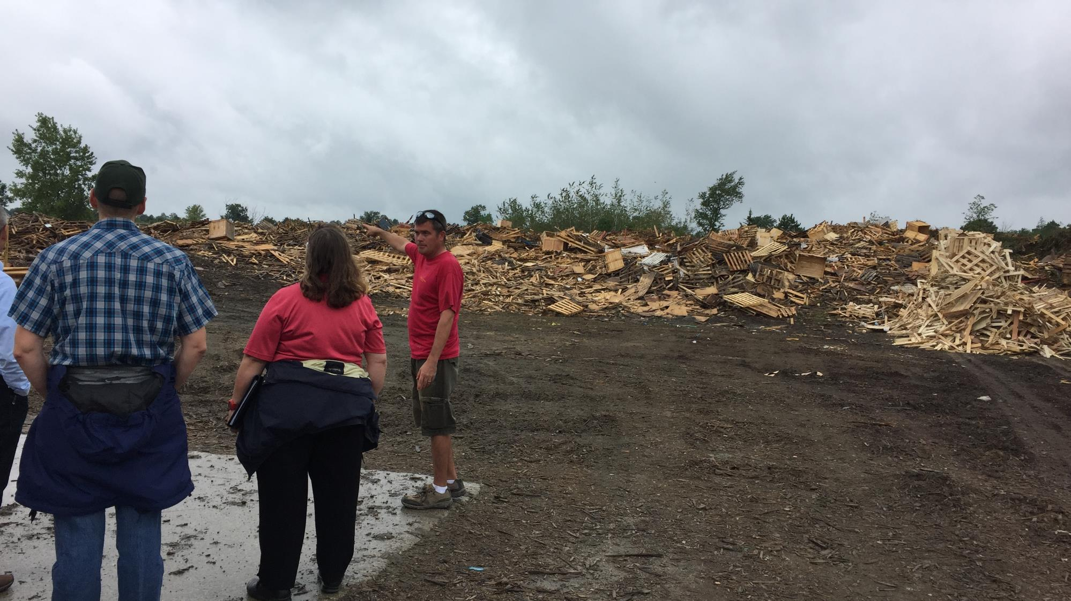
Why ‘MBIOEX?’
Notes:
A FREE internet market place for biomass
-- helping to connect buyers and sellers of woody and agricultural biomass
--

Slide 4
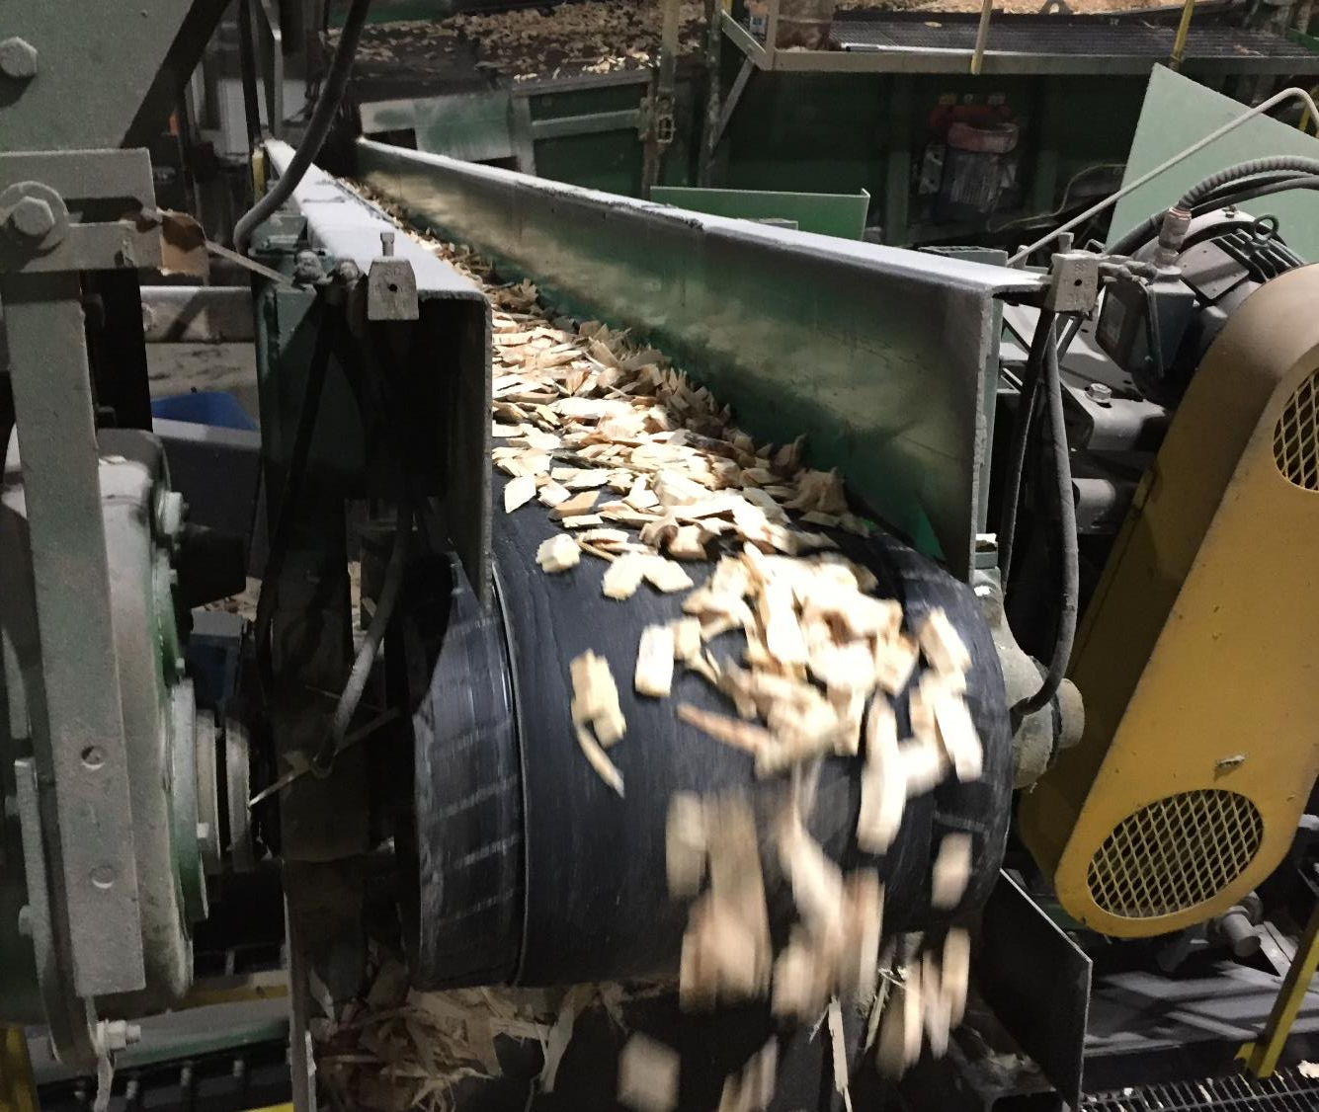
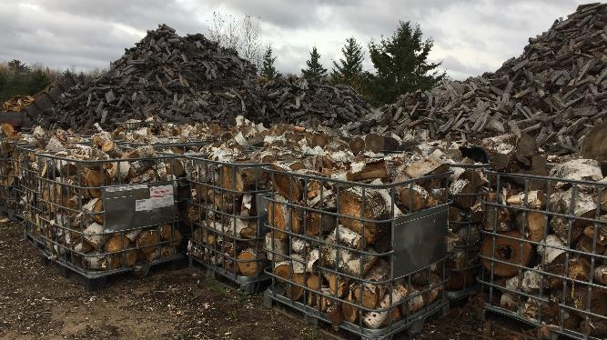
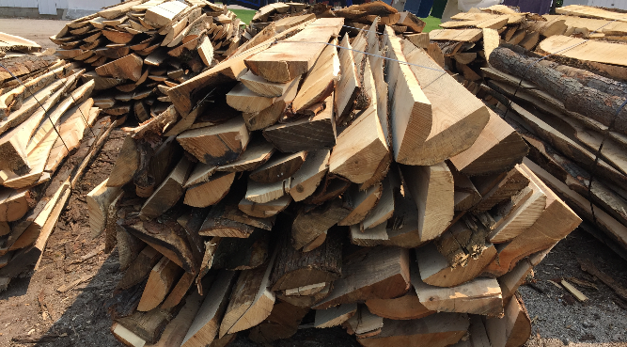

Slide 5
MBioEX can help!
Notes:
A FREE internet market place for biomass
-- helping to connect buyers and sellers of woody and agricultural biomass
--

Slide 6
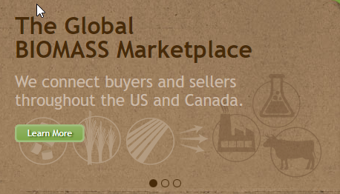
Began as ‘The Minneapolis Biomass Exchange’
Initiated by AURI & the Minnesota Clean Energy Resource Team (CERTS)
New website developed by Kevin Triemstra
Connecting buyers and sellers of agricultural & woody biomass
240+ listings from all over the world!
Notes:
Very successful market place – The first MN Biomass Exchange was initiated by AURI using grant funds. Kevin contacted them, and expressed interest in collaborating to develop a more interactive website, however there were issues with converting a grant funded project to a for-profit platform. So, Kevin developed a separate site with an interest in facilitating biomass sales, and had included brokerage services as part of the original business plan. However, over time he became involved in other things, a new job, and moved to California. But he remained interested in supporting biomass markets, and maintained the site.
We first ran across the Minneapolis Biomass Exchange last year, when Becky was leading a project to develop a list of resources that can help find local sources of biomass. We approached Kevin, expressed interest in doing something similar for the midwestern area, and to our surprise he indicated that he was willing to turn the whole site over to Heating the Midwest….

Slide 7
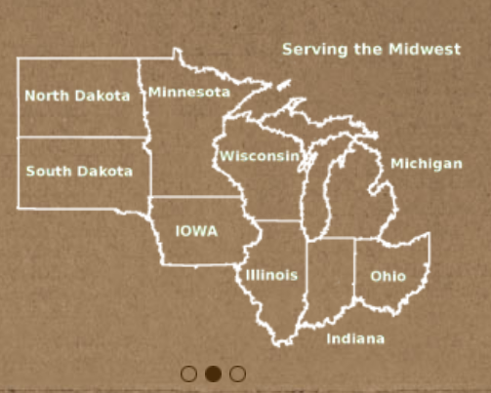
Now – rebranded & refocused as the Midwest Biomass Exchange
Domain transferred to HTM
Revision funded by the USDA FS Forest Products Marketing Unit
Platform expanded to focus on HTM’s member-states, the U.S. & Canada
Woody- and agricultural-biomass for fuels
Notes:
With a huge amount of help from Kevin, we’ve completed a licensing agreement transferring the site over to HTM.
The USDA Forest Products Marketing Unit provided funding that supported revision of the site.
And we assembled a team to work with Kevin and a software developer that he recommended to do the coding work – Venkatram Akkineni from Premier IT.
We began in August, with Kevin and Venkat working on it in their spare time, around their day-jobs.
I think they’ve done a tremendous job! So now, let me show you the site.

Slide 8
Changes:
Refocused on the US & Canada
Refocused on biomass fuels
Revised the biomass feedstock descriptors
www.mbioex.com
Notes:
The Midwest Biomass Exchange can be found on the web at www.mbioex.com
-largely retains the same format and most of the functionality of the Minneapolis Biomass Exchange
On the landing page you’ll find:
In the three pane window – links to ‘About us’ – the Exchange and it’s host – Heating the Midwest.
A map showing the service area
A short video describing the site
You’ll also find the most recent ‘for sale’ and ‘wanted’ listings on the exchange, and links to view all listings, or create a new one.
And the page also shows HTM’s Twitter post, and has links at the top to HTM’s Facebook page, Twitter feed, and Linked-In page.
The brown envelop at the bottom right shows where users can sign up for HTM’s newsletters. We hope to provide updates about the site through HTM’s quarterly newsletters.

Slide 9
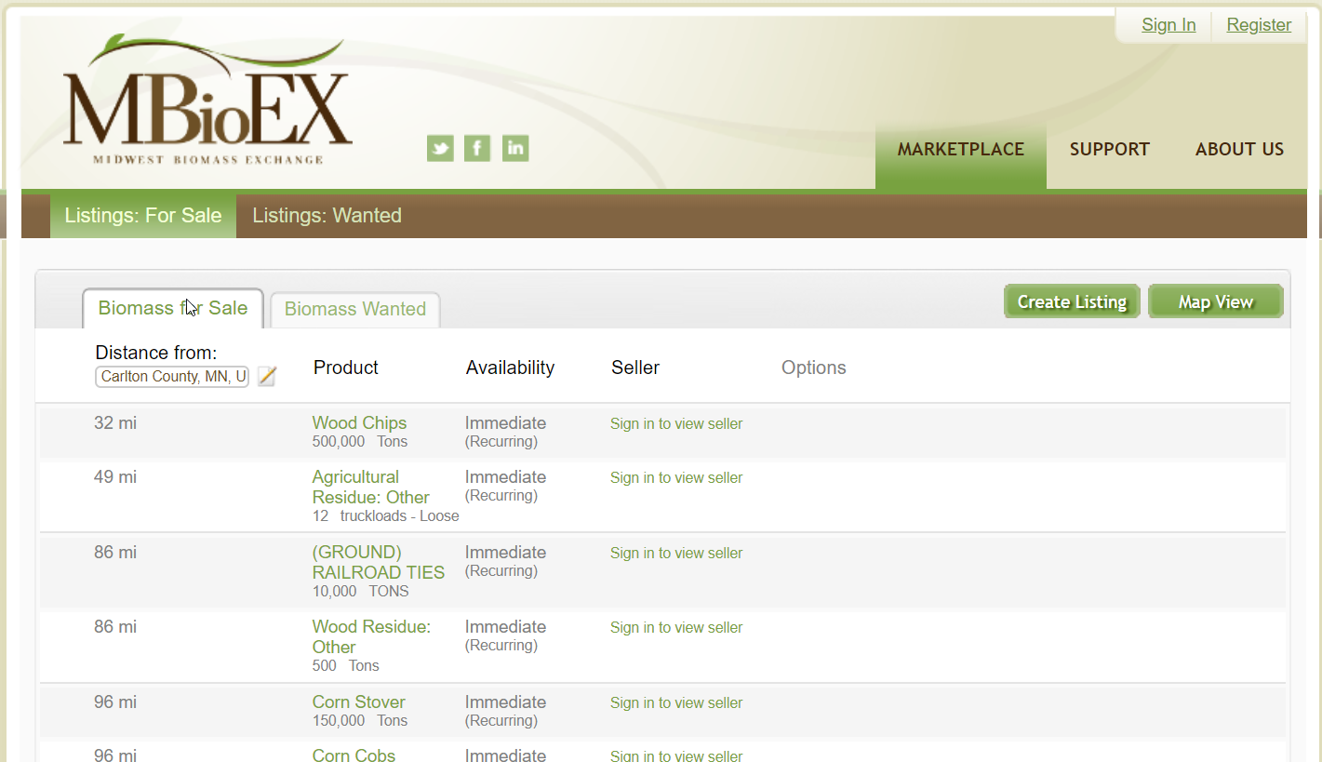
Notes:
Now if you click on the ‘view all listings’ link, you’ll see two tabs in the resulting window – one for ‘sale’ ads and one for ‘wanted’ listings.
Listings are sorted by distance from whatever city or state you enter – for example, Carleton MN.
Listings are summarized by product type, availability, and seller name – but you have to register as a user and sign in first to view user name.

Slide 10
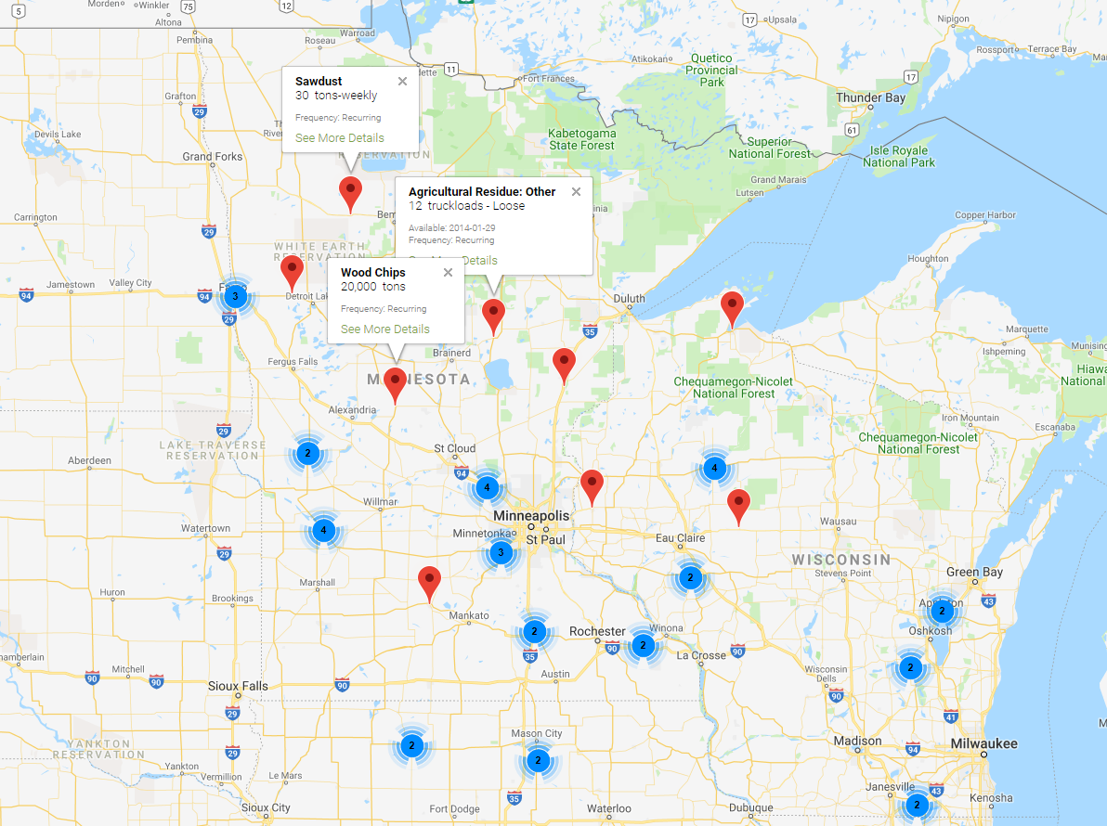

Slide 11
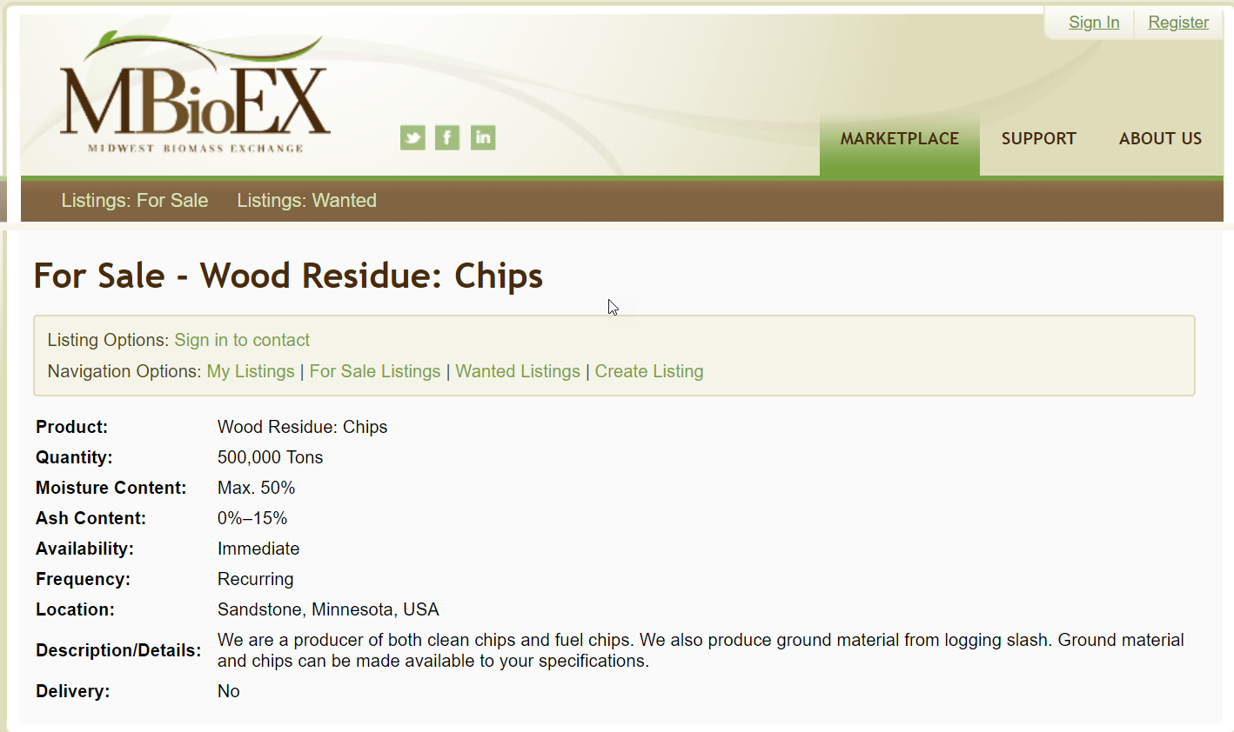
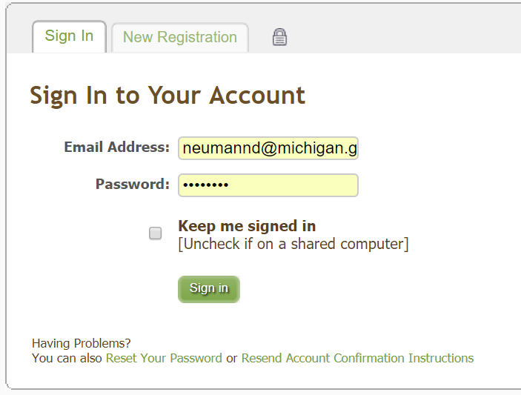
Notes:
If you click on an ad you can see more details about the listing –
Product type
Quantity offered
Moisture content
Availability
Frequency
Location (City, State, Country)
And a text description of the biomass and about the seller or purchaser.
Last, an indication of whether the person placing the ad can provide delivery services.
If you click on ‘sign’ in, the account sign in window appears, and the site can remember your password

Slide 12
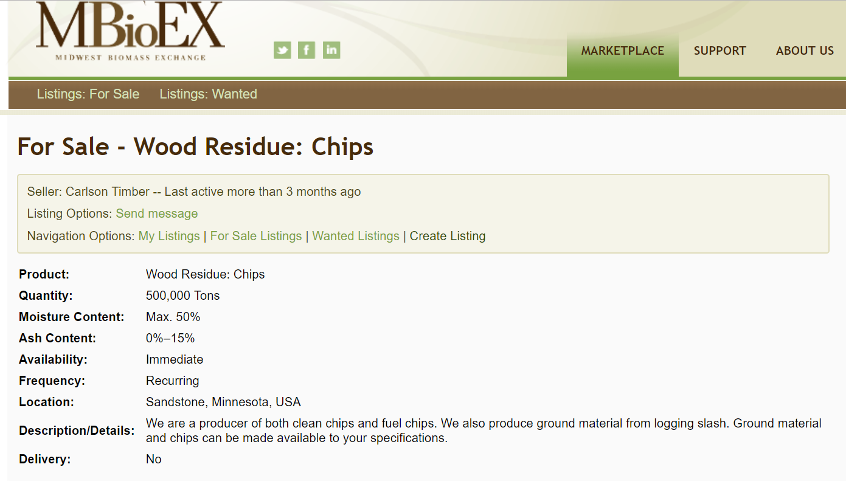
Notes:
Once you sign in – you can see the seller’s user name (not their real name) and an indication of how often they use the sight. So this user hasn’t been on the site in the last three months.
Once you’ve signed in – you can also contact the seller if you want more information or want to pursue a sale. Click on the ‘send a message button’

Slide 13
Notes:
And the site’s email utility will pop up. Type your message, and a copy will be sent to the user’s in-box in MBIOEX, and to their email address on file. By selecting the checkbox below the message window, the sender can have a copy of the message sent to their email address as well.

Slide 14
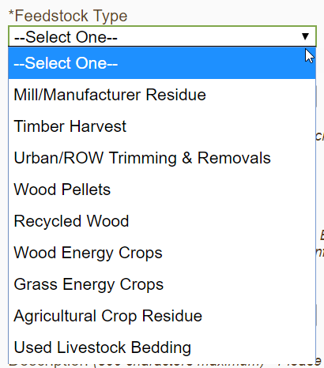
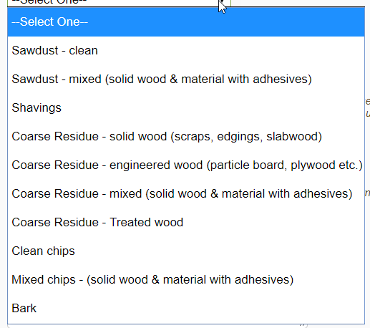
Notes:
Create a new listing – will be prompted for ‘for sale’ or ‘wanted’….
Users are prompted for a feedstock type – essentially a category for biomass type
Then are asked to select a specific feedstock within that type – in this example, Mill/manufacture residue is the Feedstock Type, and specific biomass types within that category are shown below… sawdust, shavings, coarse residue etc.
We chose this scheme to help shorten the list of biomass types one would have to scroll through, and help describe the kinds of biomass being sold better.
Feedstock type, feedstock, quantity, and price are all required items – the system won’t let you proceed without them. Price is an item that the team decided would be helpful for HTM’s use in analyzing the impact of the site, but we don’t list it in the public listings.

Slide 15
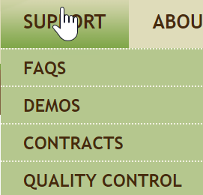
Additional Resource Tools
Under the Support menu:
Frequently Asked Questions
Demonstration videos
Sample biomass supply contract
Quality control lab listings

Slide 16
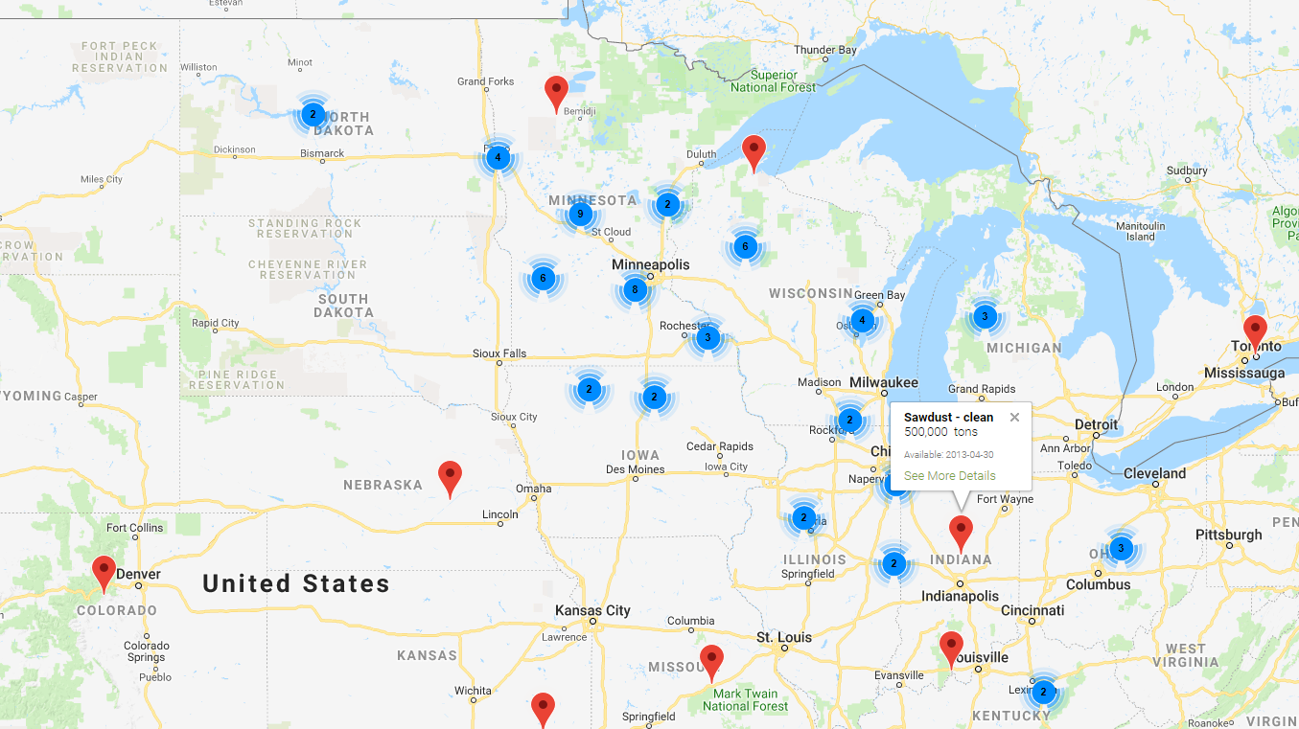
MBIOEX: Next Steps
We need your help!
Promote across the Midwest & in Canada
Support for annual hosting & maintenance (~$1,500/year)
Suggestions for improvement

Slide 17
Acknowledgements
This project was possible with financial support from:
The USDA Forest Service Forest Products Marketing Unit
Heating The Midwest
Technical assistance, advice, and mentoring from:
Mr. Kevin Triemstra & Premier IT – Venkattram Akkineni
Assistance of the HTM BR&D Action Team and project team:
Becky Philipp & Alan Doering – AURI
Kristen Bergstrand, MN DNR
Sabina Dhungana, WI DNR
David Neumann, MI DNR

Slide 18
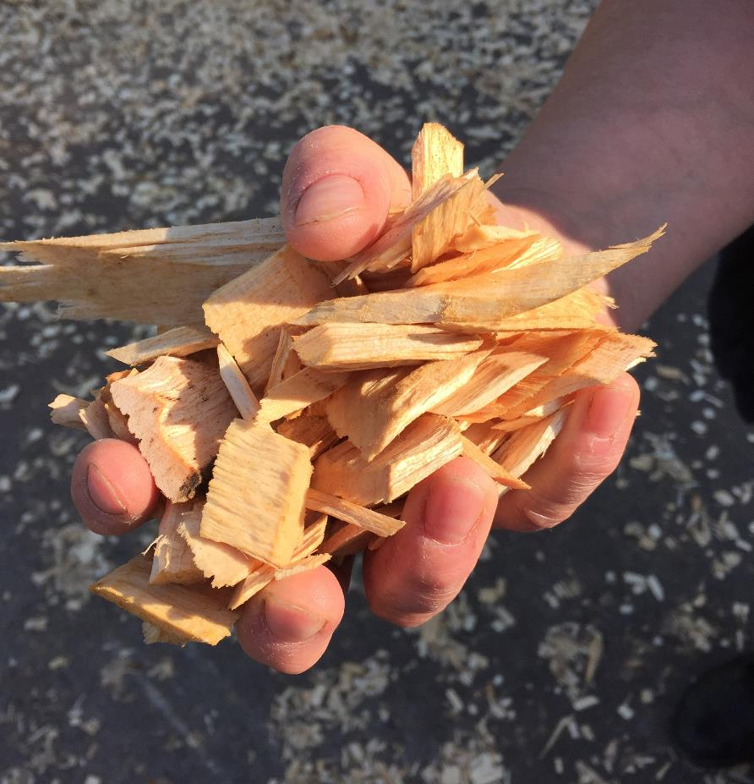
Thank You!
Questions? Contact:
David Neumann
Michigan Department of Natural Resources
neumannd@michigan.gov
(517) 284-5887

Slide 19
What is ‘MBIOEX?’
Notes:
A FREE internet market place for biomass
-- helping to connect buyers and sellers of woody and agricultural biomass
--

Slide 20
Notes:
Users also have the option to describe frequency that they can provide biomass quantities, and can indicate country, city and state.
Country is limited to the USA and Canada – in part because we recognized the close trade relationships many of the midwestern states have with Canada, and also because we wanted to avoid dealing with international trade inquiries – verifying which inquiries and companies were legitimate. Instead, for international trade, we refer users to a list of international trade contacts in the midwestern states.

Slide 21
Place holder for FAQ page

