Slide 1
Heating the Midwest

Slide 3
Duluth Energy Systems

Slide 4
Before the Tourists

Slide 5
Duluth Energy Systems

Slide 6
Duluth Energy Systems
Duluth Steam 1932 – 1979
Private Operator
Lacked financing for new air permit regulations
Duluth Steam Co-Operative 1979-2012
Completed capital needs
Low cost but status quo
Ever-Green Energy 2012 – Current
Manager and Operator
Strategic Plan
Rebranded Duluth Energy System 2015

Slide 7
Duluth Energy Systems
System Service Data:
STEAM
Four 1932 Edge Moor coal fired boilers
Two Coal Only (25 MW)
Two Coal / Gas (28 MW)
164 Buildings with Steam
150 psi steam
10 miles of distribution piping
Open Loop

Slide 8
Duluth Energy Systems
System Service Data:
HOT WATER
Energy supplied primarily by turbine exhaust steam
6 Buildings (DECC / Amsoil)

Slide 9
Duluth Energy Systems
System Service Data:
CHILLED WATER
800 Ton Steam Absorption Chiller
5 Buildings
¾ mile distribution

Slide 10
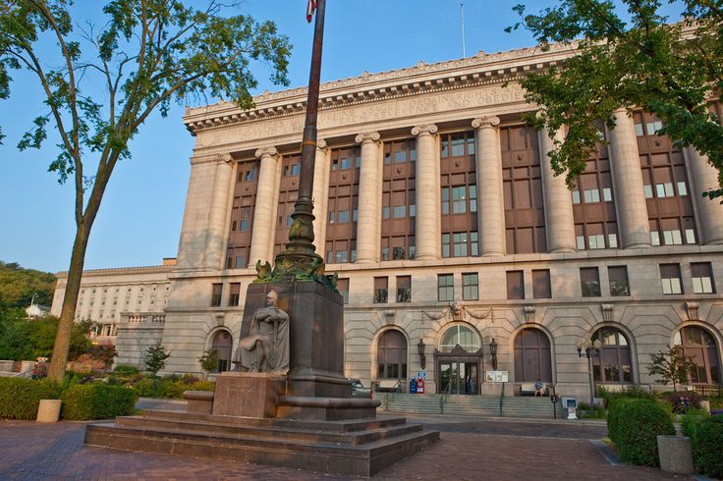
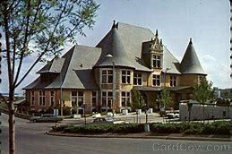
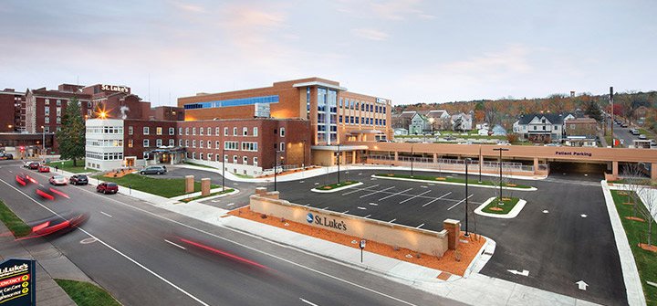
Duluth Energy Systems
We provide thermal energy for:
Hospitals
Government Buildings
Financial Institutions
Hotels
Small Shops
Tourist Centers

Slide 11
Thermal Energy Provider to

Slide 13
Strategic Plan
Critical Upgrades to Existing System
Efficiency Improvements (Hot Water)
Renewable Energy
System Growth

Slide 14
Strategic Plan
Critical Upgrades to Existing System
Total Plant Outage / Repair
Safety Upgrades
Equipment Overhaul / Replacements
Trending & Data
Gas Burner Management System Upgrade
Reliable Emergency Power

Slide 15
Strategic Plan
Efficiency Improvements
Hot Water Conversion
How to Fund?
Where to Start?

Slide 16
Conversion to Hot Water
Duluth announced intention to modernize Superior Street
17 Blocks over 3 years
Building-Face to Building-Face Project
Replacement and Upgrade of all Utilities

Slide 17
Superior Street Project
1932

Slide 18
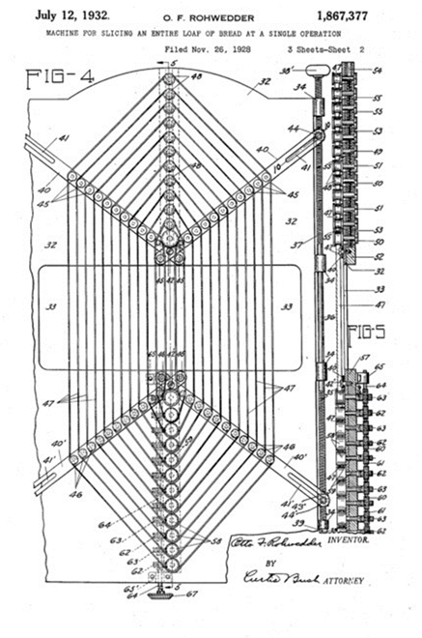
Decisions…

Slide 19
Because Compared to Steam…
Hot Water is:

Slide 20
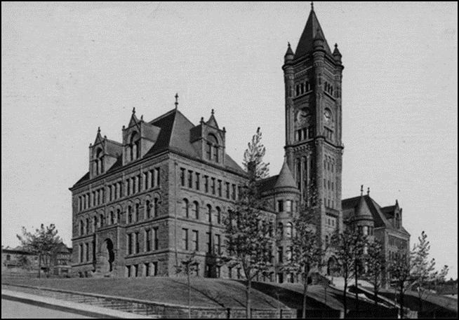
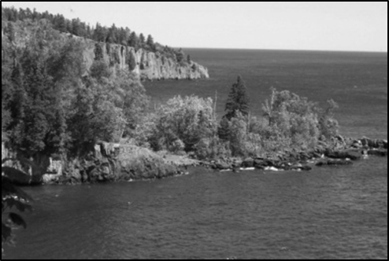
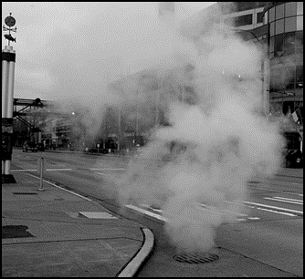
Steam System Inefficiency
365°
180°
80°
43°

Slide 21
Hot Water System Efficiency
200°
160°

Slide 22
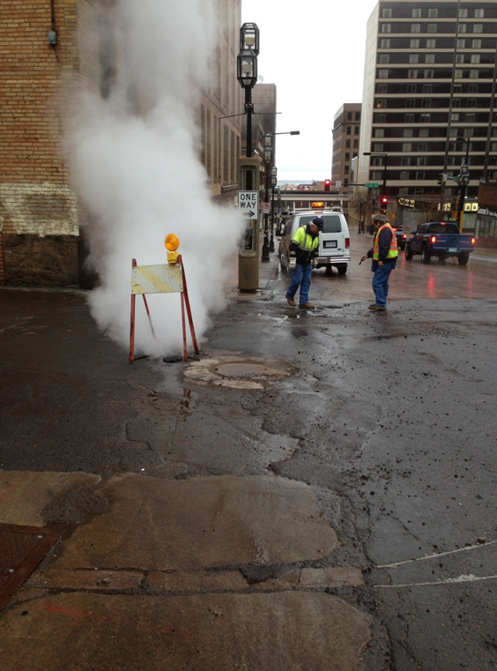
Hot Water Benefits
Up to 20% System Losses
No Manholes!

Slide 23
Superior Street Project
Bonding Request
2016 request for $21M to support the system transformation (no bonding bill)
2017 – Awarded $15M in state bonding
2018 – Request for additional $7M
Additional funds to come from other sources
Superior Street load is 30% of system

Slide 24
Superior Street Phasing

Slide 25
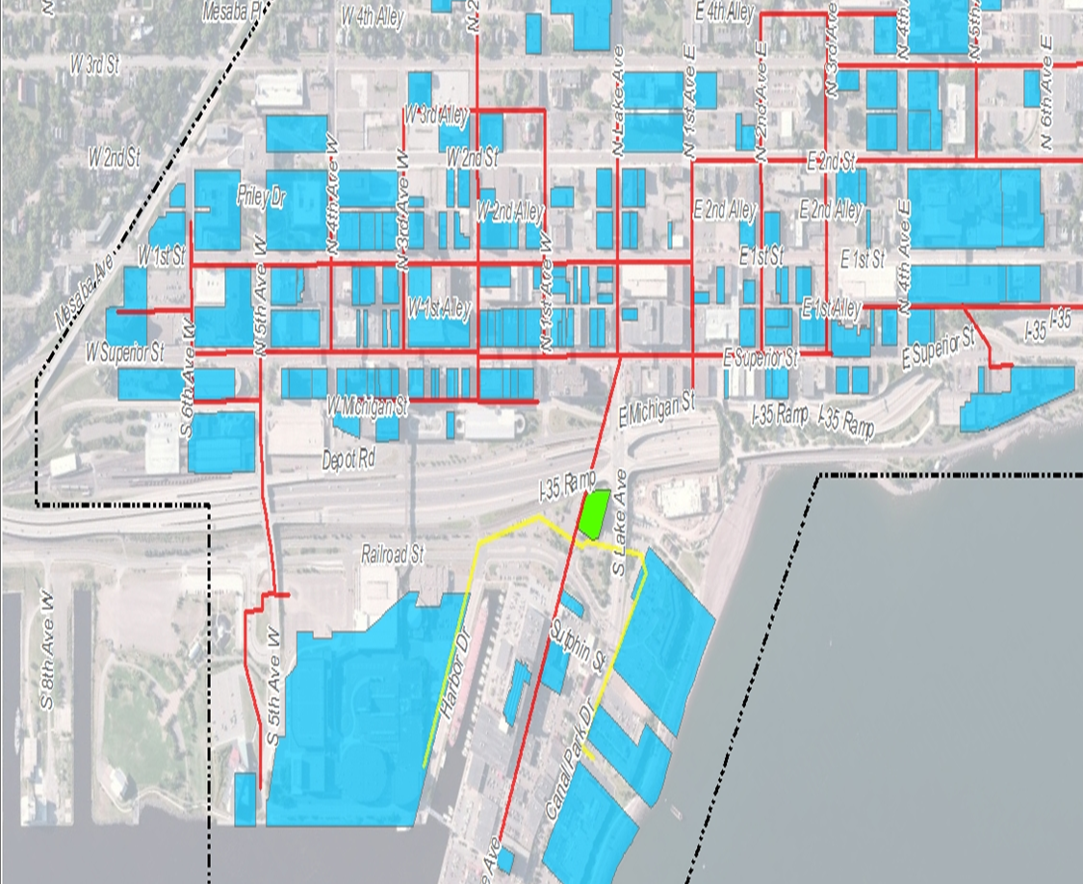
Superior Street Hot Water Routing

Slide 26
Strategic Plan
Renewable Energy
Made Possible By:
Reliable Plant
Modern Distribution
Energy Plan
Forward Thinking (EGE & City)

Slide 27
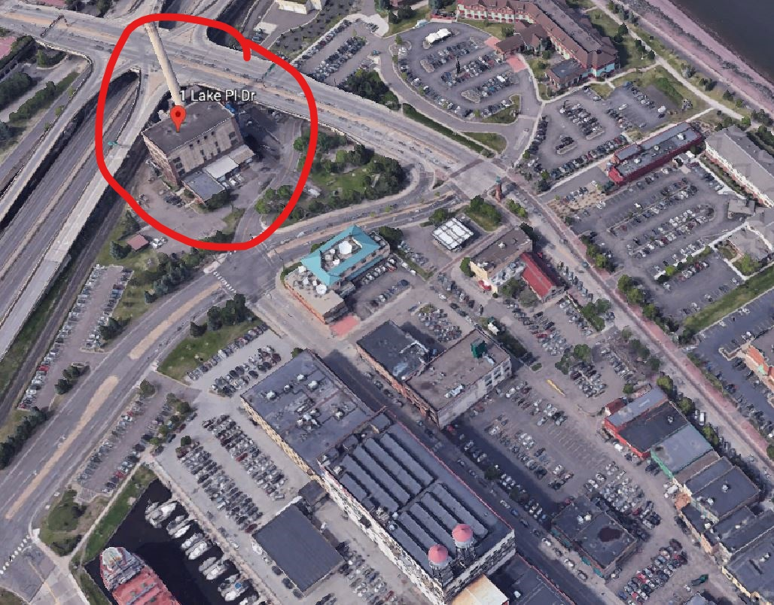
Strategic Plan
Renewable Energy
Solid Fuel & Liquid Fuel Options Investigated
Solid Fuel:
Capital intensive
Significant space requirements
Messy process in the heart of the tourist district
RFO
Easier boiler retrofit
Less intensive capital costs
Less visible

Slide 28
RFO Operation
RFO will become our base fuel, coal and natural gas will be supplemental
Boilers 1 & 4
RFO, Natural Gas and Coal Capability
Ability to fire on RFO and Natural Gas or Coal simultaneously
Base load of RFO to provide “Comfort Heat”
Remaining load of coal or gas to provide “Process Heat”
Boilers 2 & 3 will have Natural Gas and Coal Capability

Slide 29
RFO Operation
Rail Distribution to area
Off-Load and truck to Duluth Energy Systems
Multiple days of capacity in on-site storage tanks

Slide 30
Next Steps
Permit work has begun
Need to determine what pollution control equipment is needed for RFO / Natural Gas combination
Current agreement will displace between 1/3 and ½ of current fuel requirements

Slide 31
Strategic Plan
Lower Costs
Increased Reliability
Forward Thinking
Modern Distribution

