Slide 1
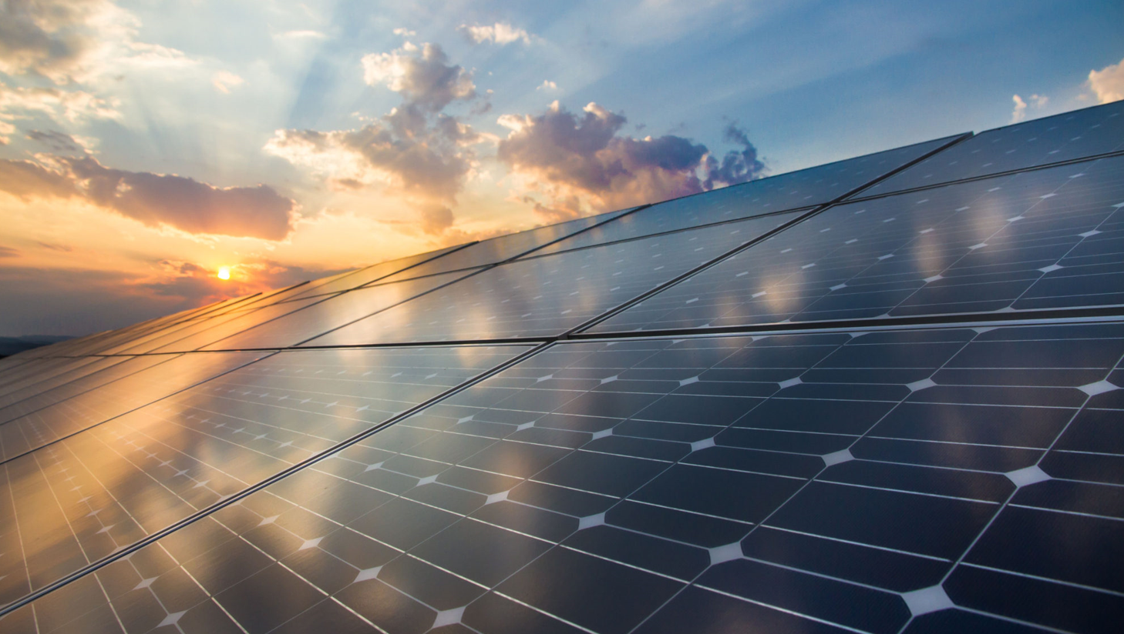
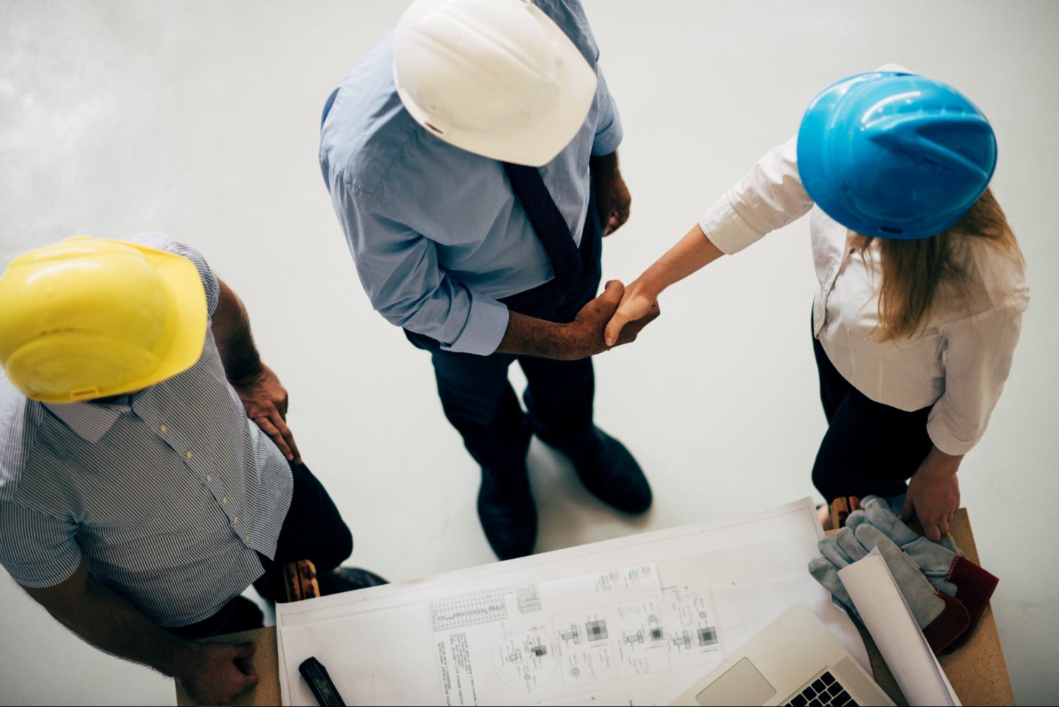
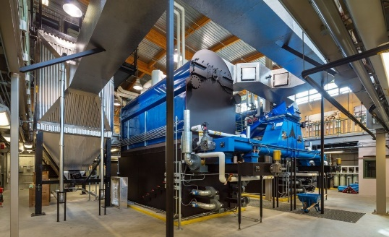
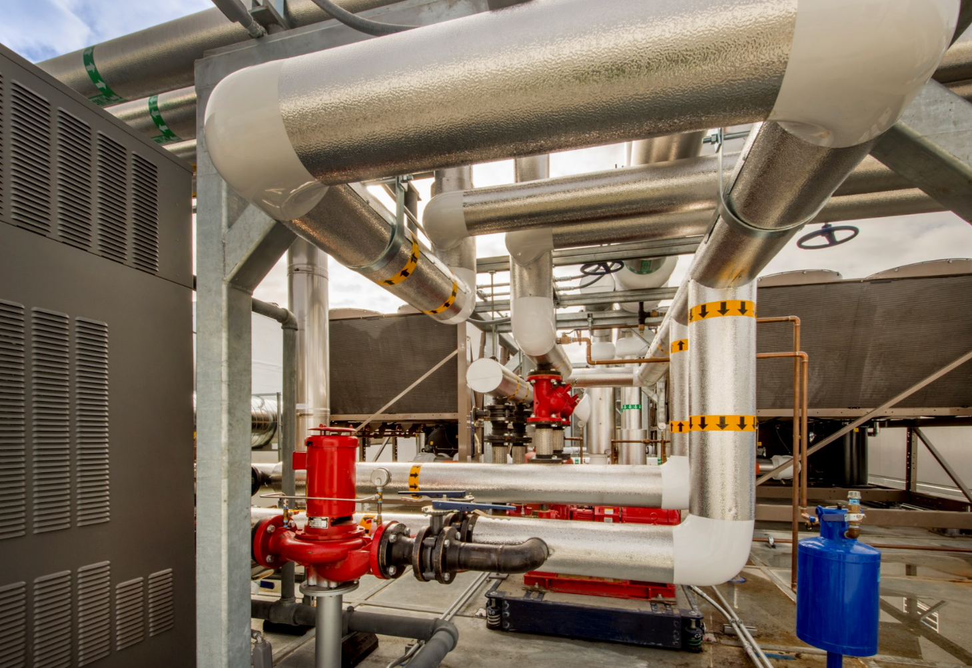
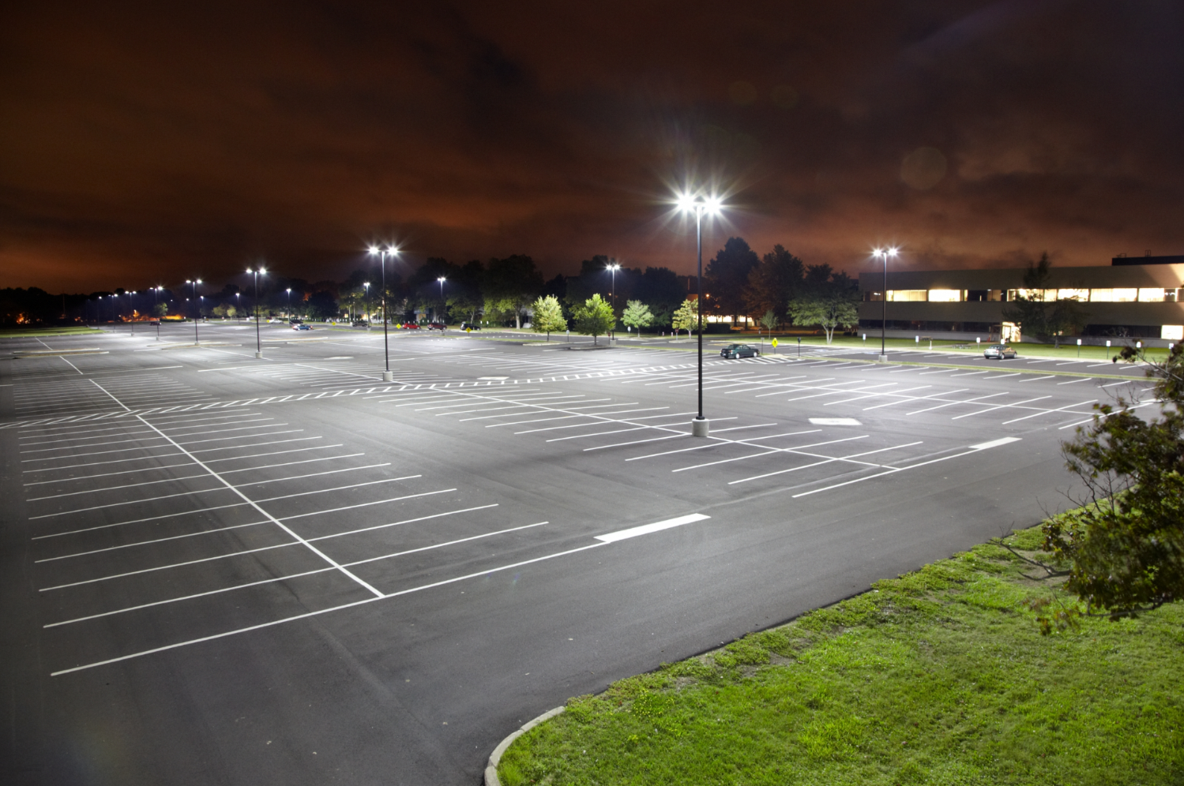
How PACE can help future biomass projects
Tony “T.J.” Morice
5/2/18
TNT Ventures LLC & Verita Energy LLC

Slide 2
Sources of Information
TNT Ventures LLC

Slide 3
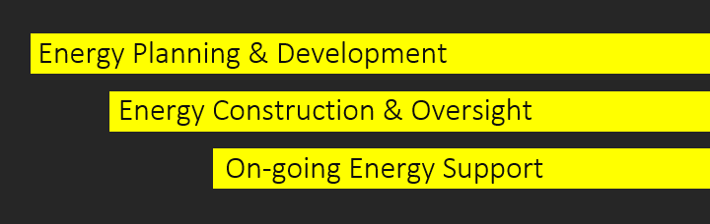
How are we involved
VERITA Energy LLC is a team with over 75 years combined experience
WHAT WE DO—OWNER ADVOCACY:
Messersmith Manufacturing since 1982.
Turn-key biomass boiler system installations
Engineering Design & Layout Assistance
Boiler System & Fuel Handling Equipment
Installation, Commissioning & Operator Training
Full Service & Support for the life of the system
Over 120 successful installations in U.S.
from Maine to Alaska.
Output from 500,000 to 35MMBTU+/hr
TNT Ventures LLC
Experience in coordinating and educating numerous biomass combustion systems projects over the last decade in the Midwest and other select areas.

Slide 4
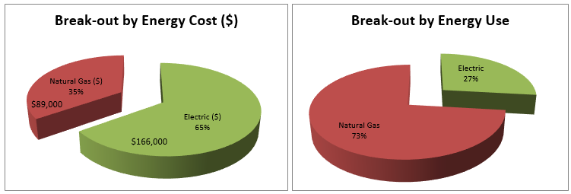
Utility Rate Analysis & Facility Review to start
Example analysis for 196,000 square foot facility
Electric
Energy Use: 1,540,000 kWh/yr
Average Cost: $166,000/yr
Blended Rate: $0.108/kWh
Natural Gas
Energy Use: 144,000 therms/yr
Average Cost: $89,000/yr
Blended Rate: $0.62/therm
$31.63/MMBtu
$6.20/MMBtu
Total Annual Energy Cost: $255,000

Slide 5
How We Holistically Serve Clients
Utility Rate Analysis & Benchmarking (before)
Energy Procurement
Energy Efficiency
Renewable Energy
Utility Rate Analysis & Benchmarking (after)

Slide 6
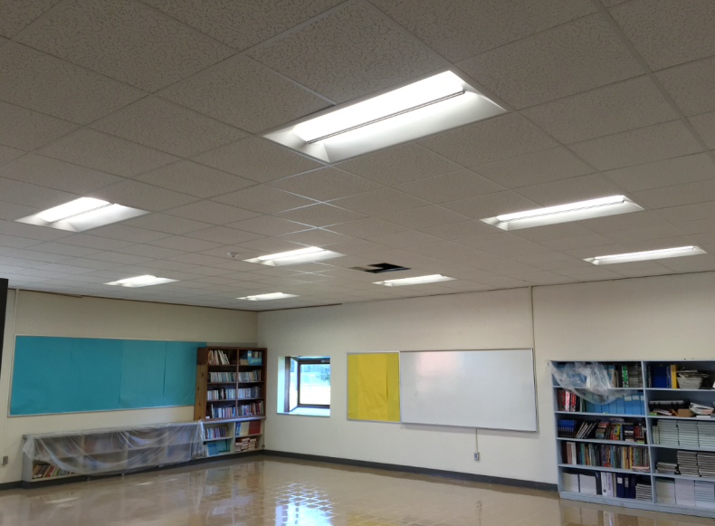
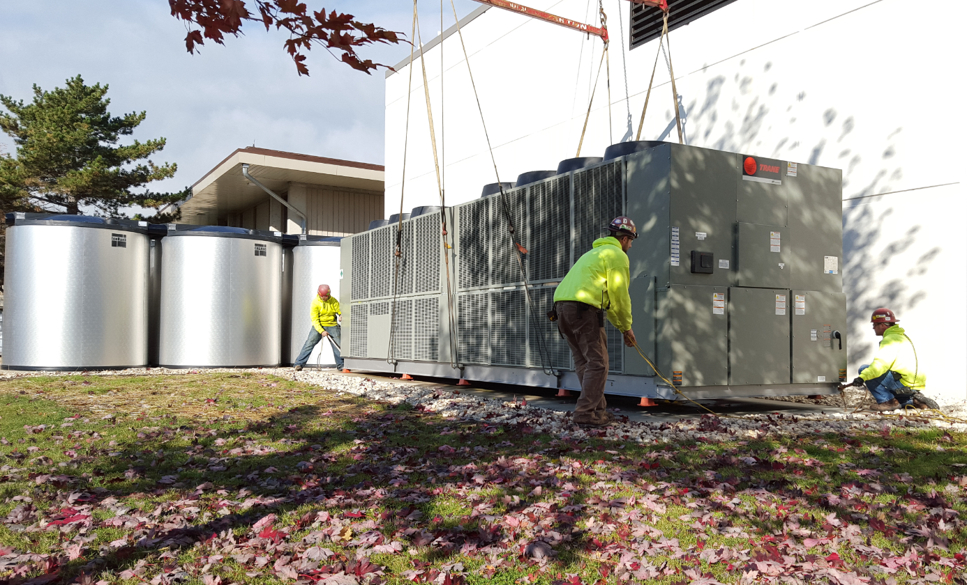
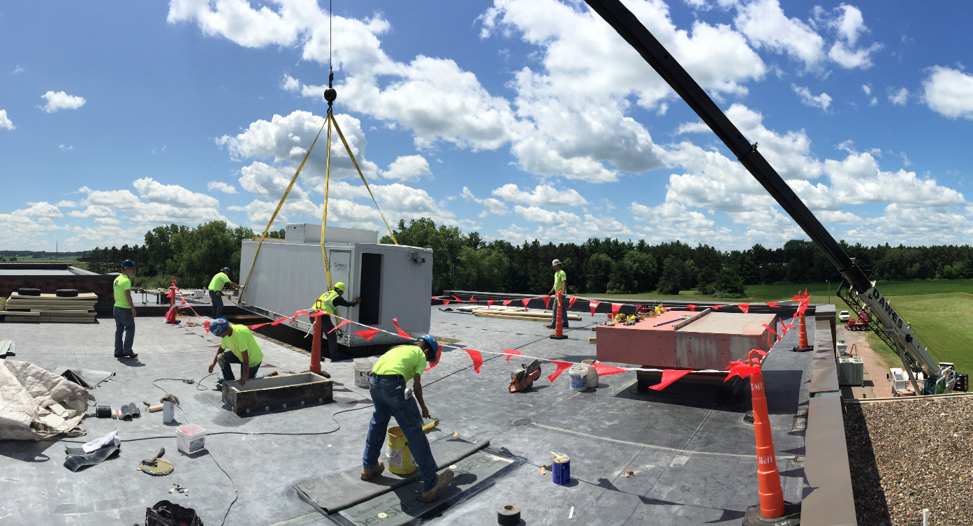
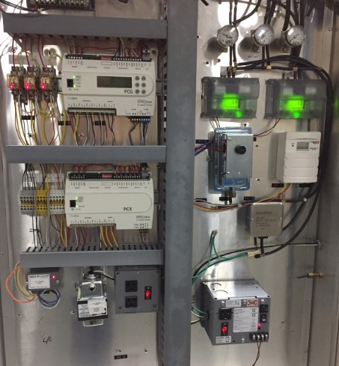
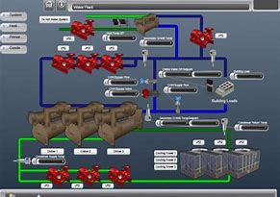
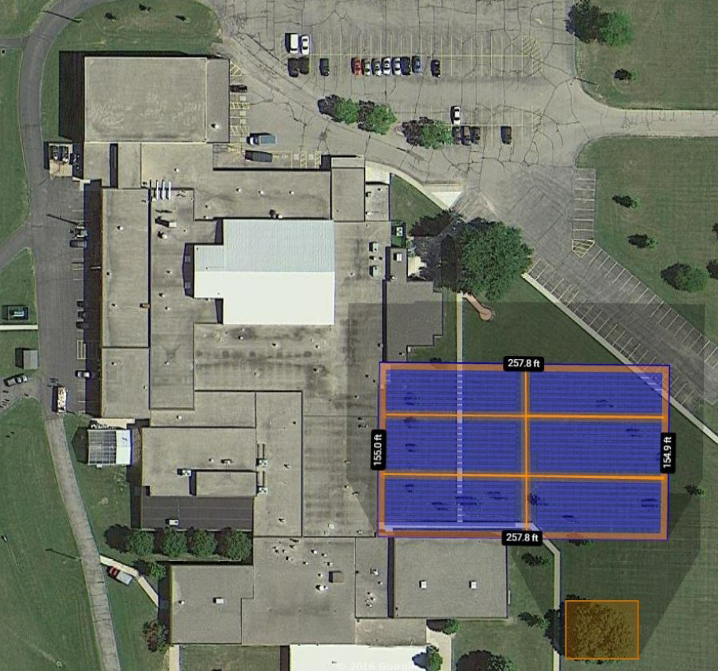
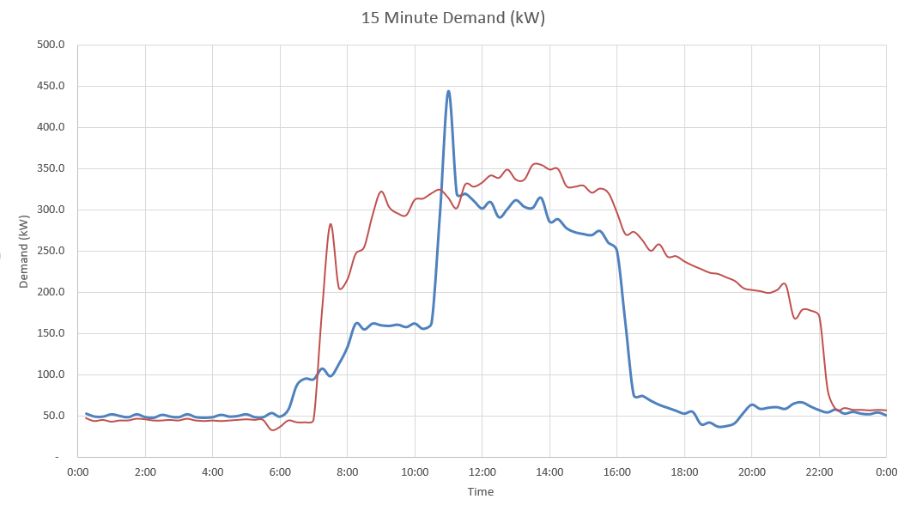
Energy Efficiency
Efficiency is a complex organism
Efficiency must be married with demand management, conservation, procurement, and the potential for renewable energy. Overarching all this must be sound financial ideas that serve the greatest good of the client. Period!
It’s about the details and understanding the tariff

Slide 7
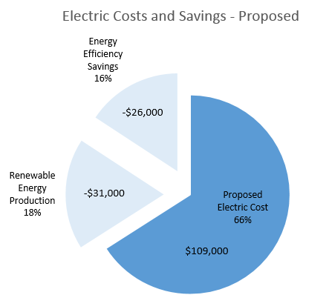
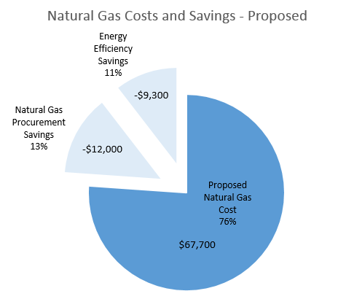
Facility Benchmarking - After
 | Existing |  | Savings |  | Proposed
Annual Electric Costs ($) | $166,000 |  | $57,000 |  | $109,000
Annual Natural Gas Costs ($) | $89,000 |  | $21,300 |  | $67,700
Annual Energy Costs ($) | $255,000 |  | $78,000 |  | $177,000
Annual Energy Costs ($/sq-ft) | $1.30 |  | $0.40 |  | $0.90
% of Existing | -- |  | 31% |  | 69%
31% reduction in energy costs

Slide 8
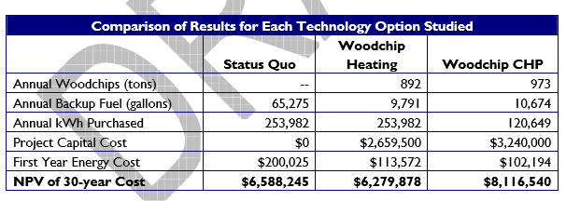
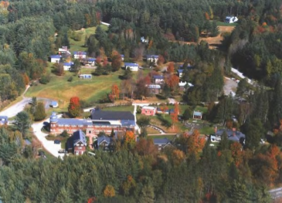
Goddard College-- Plainfield, VT

Slide 9
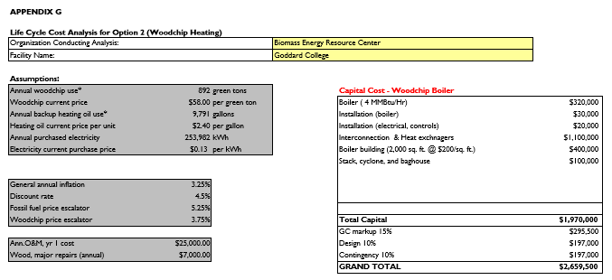
Goddard College – LCA & Funding Scenarios

Slide 10
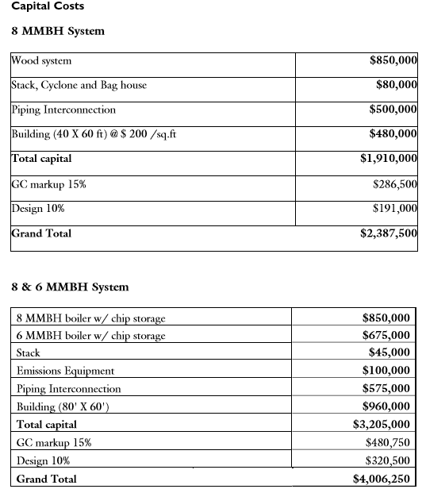
Grafton County-North Haverhill, NH

Slide 11
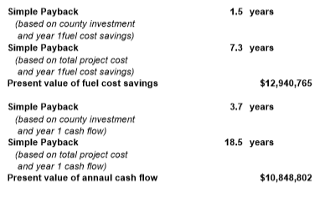
Grafton County—LCA & Payback

Slide 12
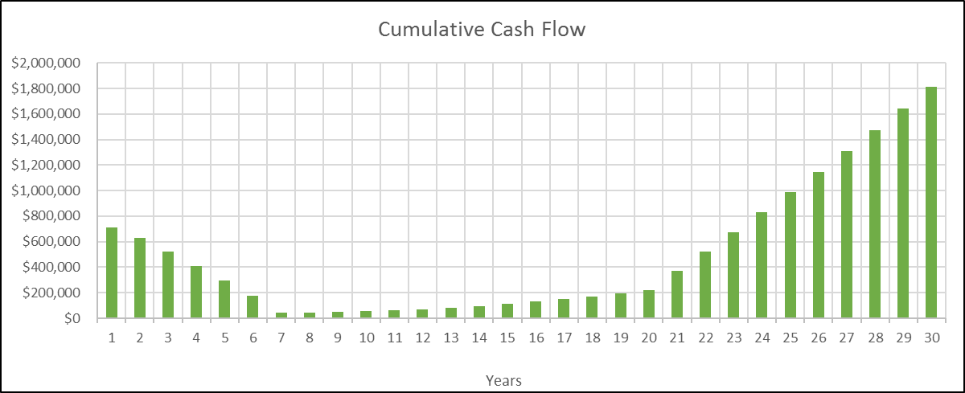
Financing Options
Governement Grants/Programs
Local financing options
Shorter term with lower rates
Outside capital investor financing
Shorter term with lower rates (more understanding of projects)
3rd party financing on renewables
Property Assessed Clean Energy (PACE)
Tied to property taxes
Lending up to 25 years

Slide 13
PACE (Public Assessed Clean Energy)
Financing for 100% of PACE project cost
Long repayment periods: up to 30 years.
Positive cash flow
Increase property value
Non-recourse financing (no personal guarantees)
Transfers to new owner upon sale
Energy savings performance guarantees

Slide 14
PACE Implementation

Slide 15
National Pace Coverage

Slide 16
Each state make up is different--WI
Check your local areas and if projects are in counties that don’t currently allow PACE further education may be the key

Slide 17
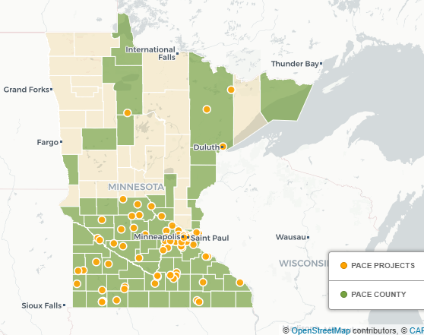
MN summary
PACE of MN is now available for any community through the simple step of adopting a standardized Joint Powers Agreement.
Within a matter of weeks, any community can move from interest to PACE implementation – and Eutectics is pleased to assist your community in making PACE a reality for your commercial, industrial and non-profit buildings.
Contact Eutectics today to get the process started in your city or county, and to make long-term, affordable financing available for energy efficiency and renewable energy projects in your community!
Contact us at 612.353.5760 or Info@EutecticsLLC.com to get started on your PACE project today.

Slide 18
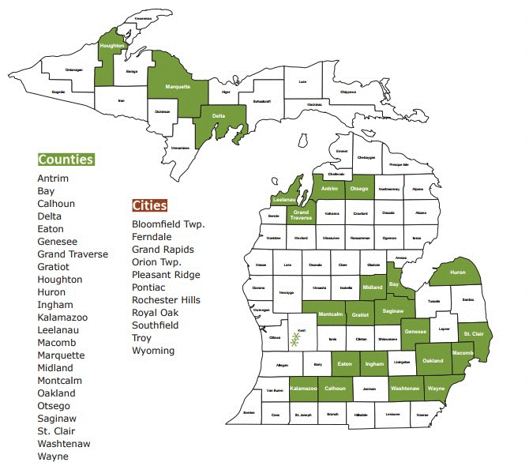
MI summary
PACE special assessments feature terms of 10 to 20 years (up to the useful life of the improvements or equipment involved) – much longer than a traditional bank loan.
Under Michigan's PACE statute, the contractor doing the work must guarantee the energy savings on all projects of $250,000 and up.
Bottom line: property owners doing PACE projects approved as part of Lean & Green Michigan will generally pay nothing down and will generate more money in energy savings than their payments to service the special assessment. The project will be cash flow positive from beginning to end. In fact, under Michigan's PACE law, this savings to investment ratio must be positive on day one as a condition of project approval.

Slide 19
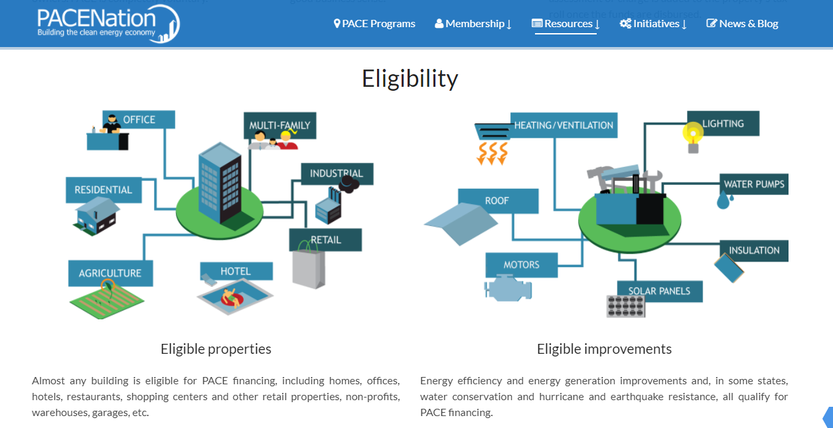
Eligible Properties & Improvements

Slide 20
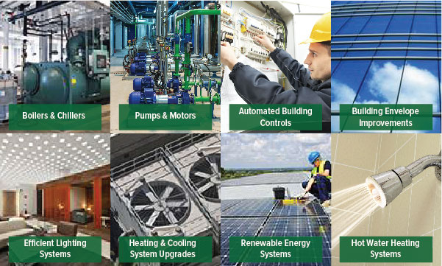
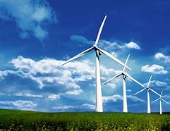
Specific Visual Example Projects
Biomass
Solar
Wind

Slide 21
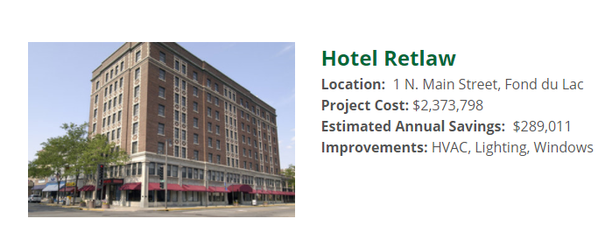
WI Example Projects
Sola
Wnd

Slide 22
Nationwide Commercial Projects 3/14/18

Slide 23
Types of projects nationally so far…..

Slide 24
Specific distribution of facilities

Slide 25
Regional Project Distribution

Slide 26
Thanks for your attention
tj@veritaenergy.com
Tony.morice@mepsolutions.org

