Slide 1
Success with Biomass CHP in Saint Paul
Jeff Guillemette
Ever-Green Energy

Slide 2
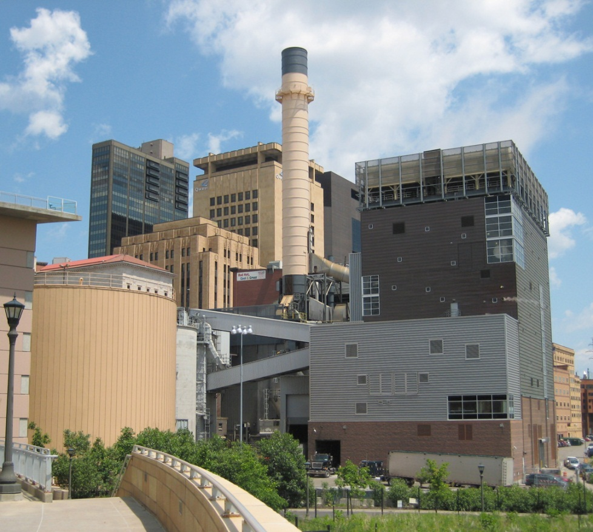
St. Paul Cogeneration Combined Heat & Power
25 MW of electricity
Dual fueled – NG and renewable, clean, urban wood residue
Greenhouse gas CO₂ reduced up to 280,000 tons per year
District Energy St. Paul

Slide 3
Community Scale Heating and Cooling
Underground network of pipes that aggregate building heating and cooling (thermal) loads
Aggregated thermal loads allows application of technologies and fuels not feasible for individual buildings
Increases fuel flexibility, efficiency, rate stability, reliability & reduces emissions
District Energy St. Paul

Slide 4
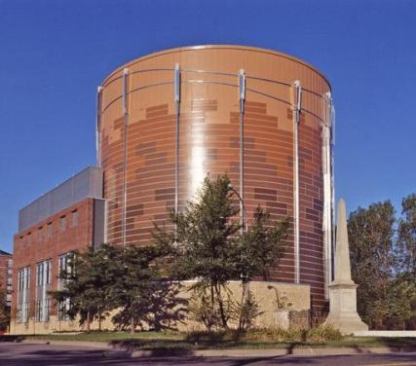
Thermal Storage
6.5 million gallons of storage capacity
Chilled water storage reduces peak-electric demand
Firm capacity for weather events

Slide 5
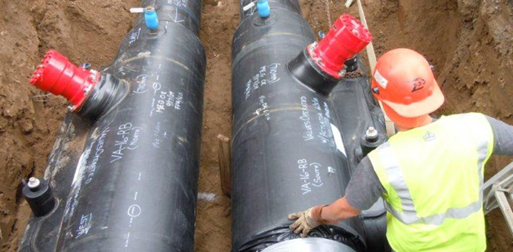
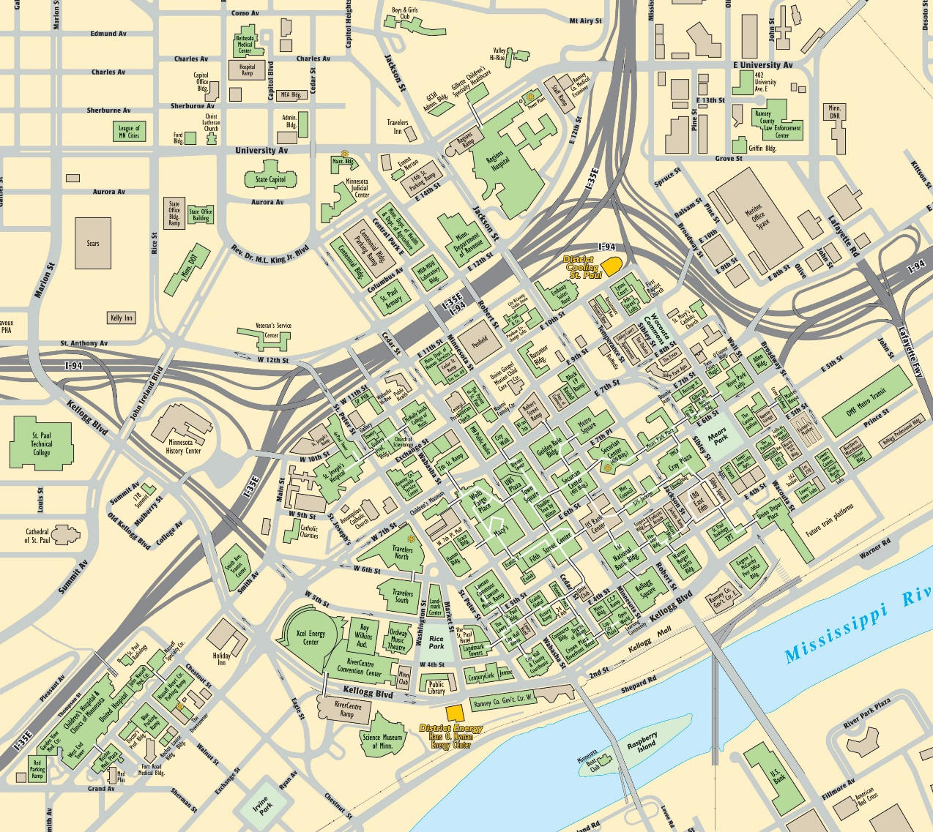
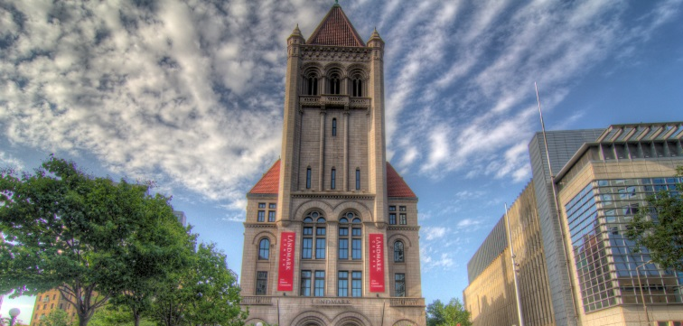
Heating and Cooling a City

Slide 6
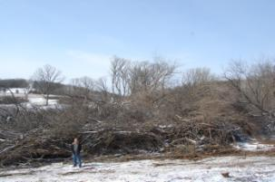
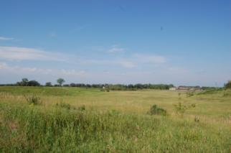
Local Biomass Incorporation
Local wood collection helps cities and counties convert a waste wood problem to renewable energy
Sources
Wood residuals from manufacturing
Clean wood construction waste
Tree trimmings
Storm and disease damaged trees
Trees removed as part of a timber management plan/restoration

Slide 7
Biomass Advantages:
Large quantities in MSP metro area
Using for biofuel diverts clean wood waste from landfills
Provides communities an economical way to dispose of wood waste
Stable fuel cost
Biofuel expenditures stay in local community

Slide 8
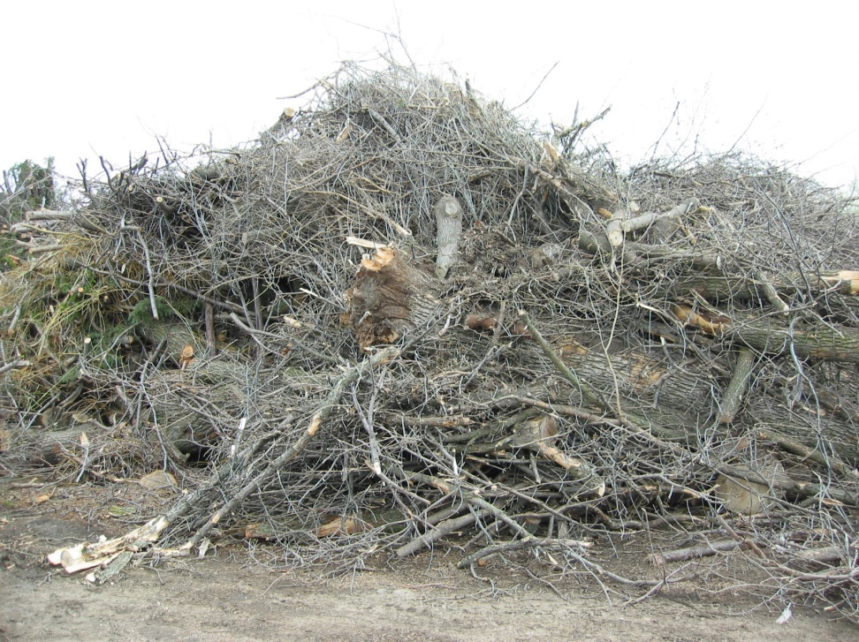
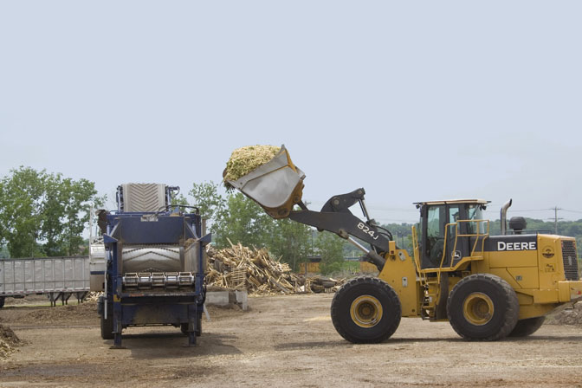
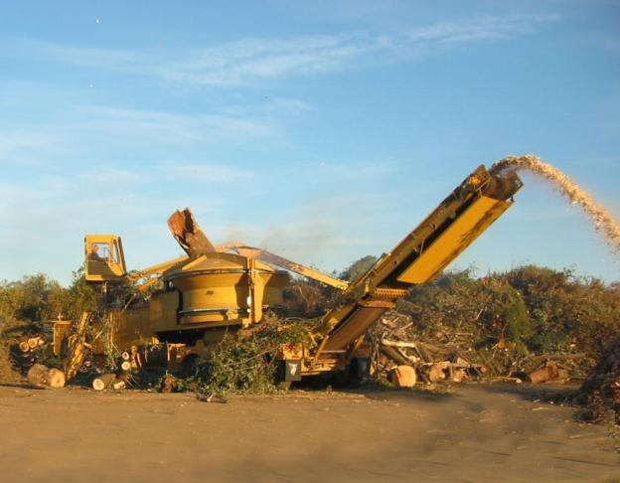
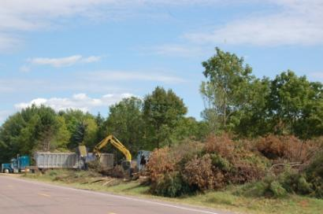
Processing Wood Waste Into Biofuel

Slide 9
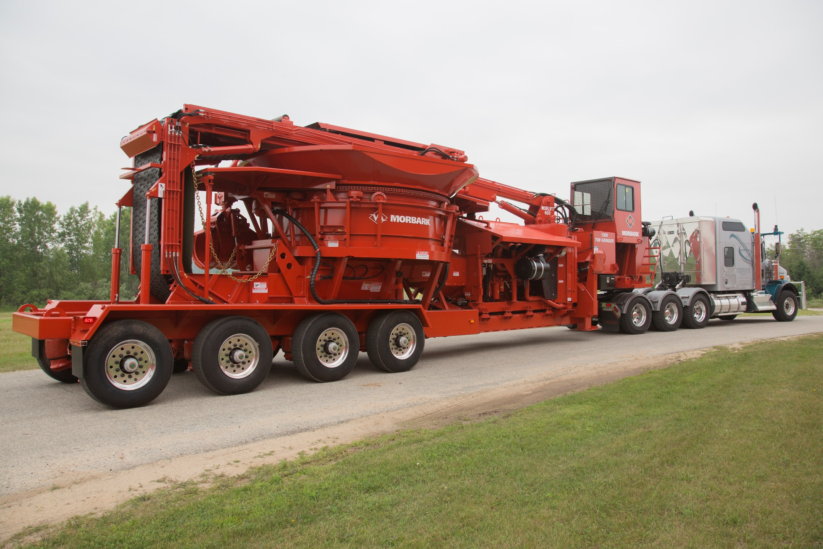

Slide 10
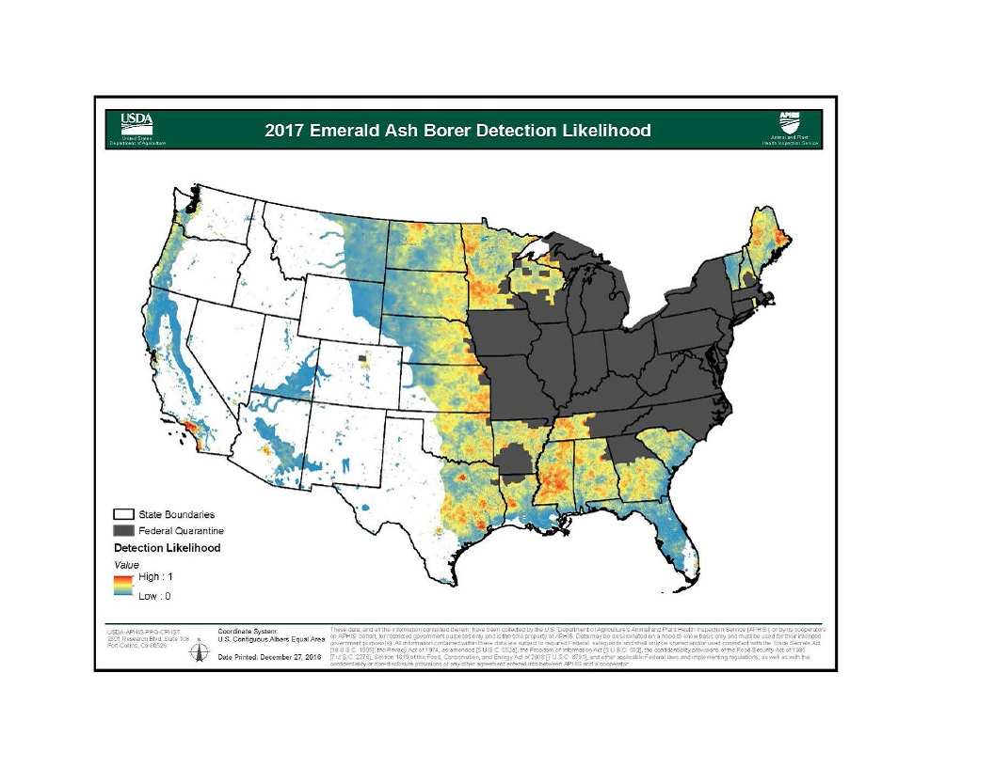

Slide 11
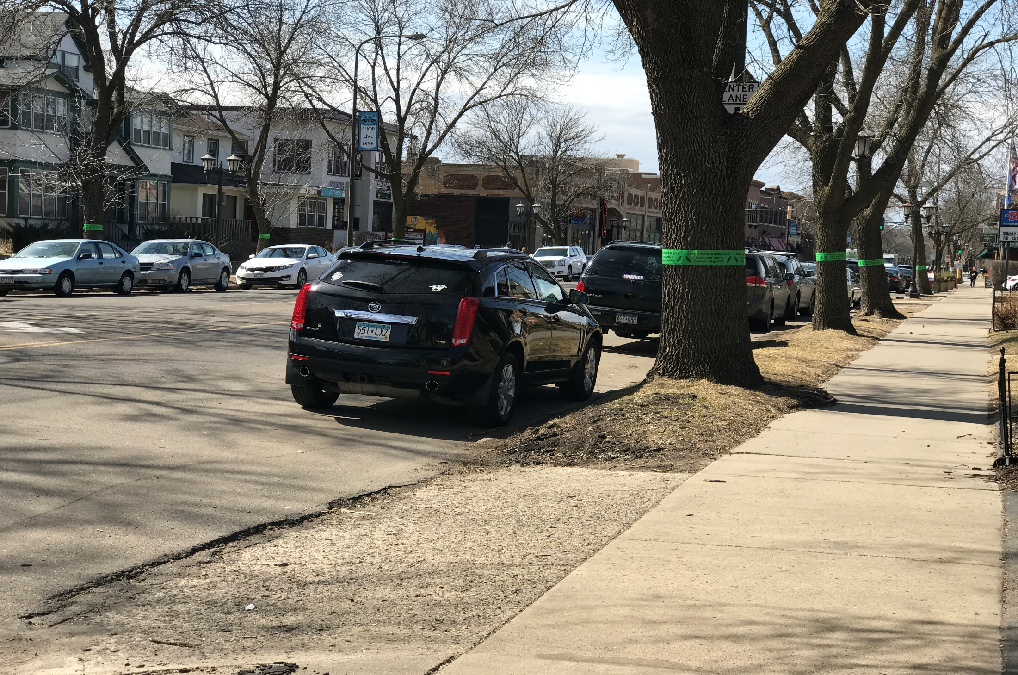

Slide 12
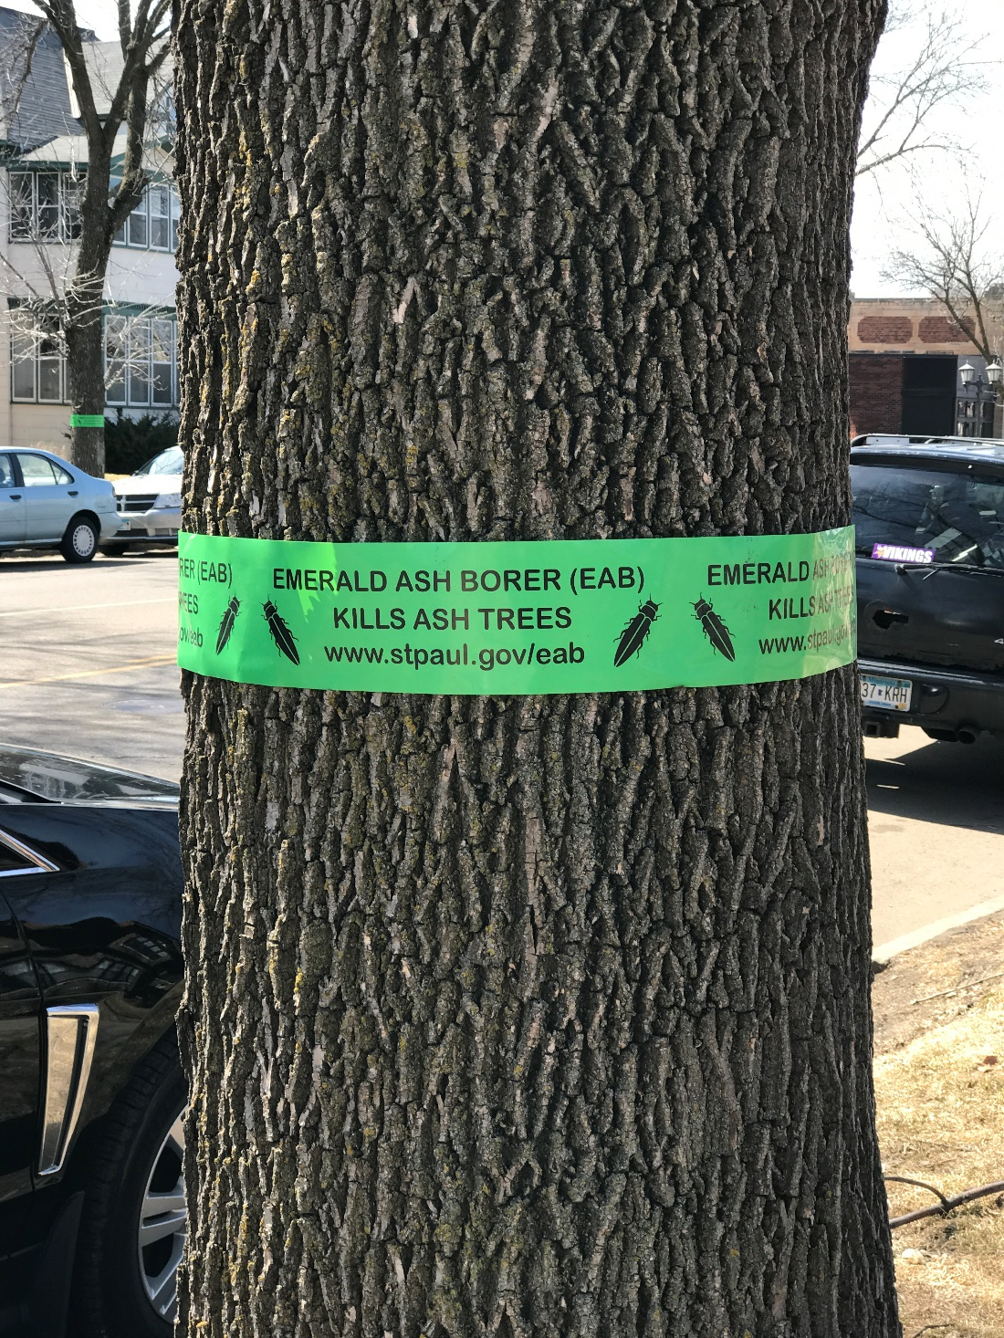

Slide 13
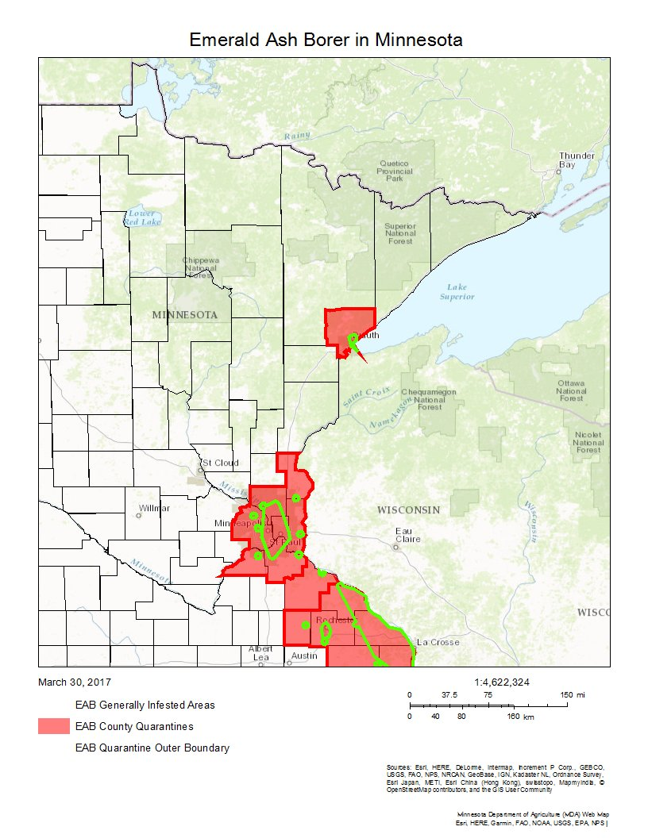
Emerald Ash Borer Status
14 Counties currently under quarantine

